Slide 1

VIDHARBHA YOUTH WELFARE SOCIETY,AMRAVATI
PROF. RAM MEGHE INSTITUTE OF TECHNOLOGY
& RESEARCH, BADNERA-AMRAVATI

Slide 2
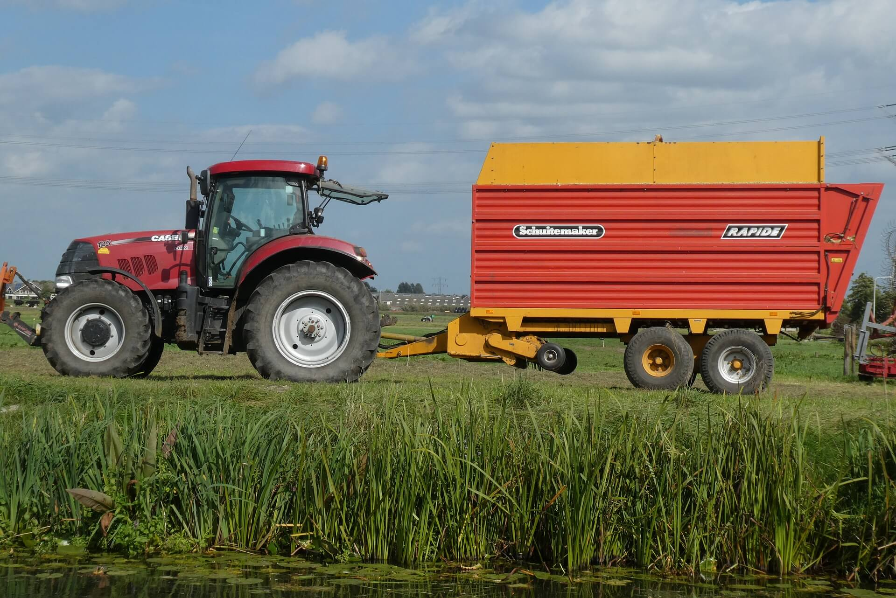
Implementing Machine Learning for Smart Farming to Forecast Farmers Interests in Hiring Equipment
VIDHARBHA YOUTH WELFARE SOCIETY, AMRAVATI PROF. RAM MEGHE INSTITUTE OF TECHNOLOGY & RESEARCH, BADNERA-AMRAVATI
UNDER THE GUIDANCE OF –
PROF.G.J.SAWALE
PRESENTED BY –
YASH SAWARBANDE
SWARAJ RAWATE
ROSHAN DEHANKAR
ANUSHKA SHELKE
This Photo by Unknown Author is licensed under CC BY

Slide 3
CONTENTS
ABSTRACT
INTRODUCTION
LITERATURE REVIEW
SYSTEM ARCHITECTURE
WHAT IS DECISION TREE AND K-MEANS CLUSTERING ALGORITHM
METHODOLOGY
IMPLEMENTATION & RESULTS
CONCLUSION & FUTURE SCOPE
REFERENCES

Slide 4
ABSTRACT
Farming is the backbone of Indian economy. In this agriculture sector, there is a lot of fieldwork, such as weeding, reaping, sowing etc. these operations previously were done by traditional equipment’s. Working with that equipment’s was tedious and laborious. Also traditional ways are time consuming. Mechanization in agriculture made farming easier and quick. There are variety of machines are available for almost every task in agriculture. Beginning with preparing land to the harvesting of crop and further process can be done by machines. The agriculture machineries that are used now days are costlier and cannot be afforded by most of farmer with rural background. Most of the farmers in India own very small pieces of land and owning these costlier machines may not be feasible for them. Apart from this most of farmers consider the traditional ways of farming as primary methods. Considering above mentioned factors there is need to develop such a system which will recommend and suggest essential equipments on rent to improve farming .

Slide 5
INTRODUCTION
It is necessary to put agriculture on automation the current rate of agricultural production required to feed the world population cannot be realized without mechanization.
In this Project, we proposed a two way decision support system using which farmers will get required equipments recommendations for hiring the equipments to improve farming and on the other hand equipment owner will get analytics report about registered farmers and their requirement.
In this project we proposed decision tree algorithm to develop decision support system.
In our proposed system there will be 3 users admin, farmer and equipment owner .

Slide 6
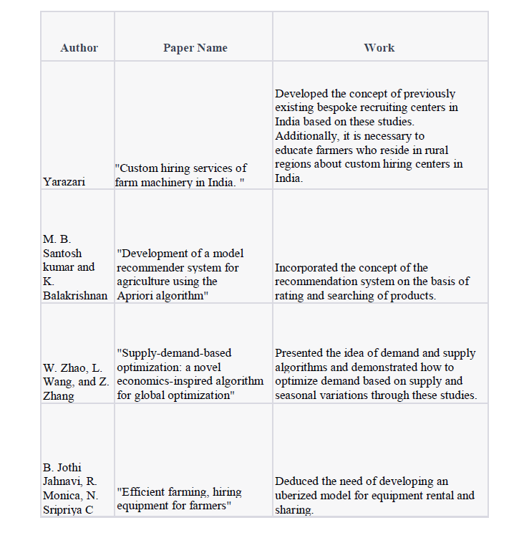
LITERATURE REVIEW

Slide 7
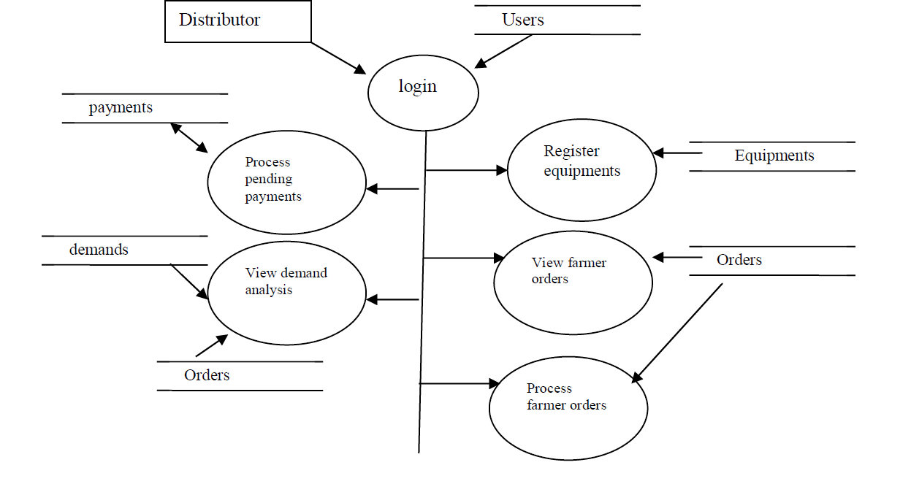
SYSTEM ARCHITECTURE

Slide 8
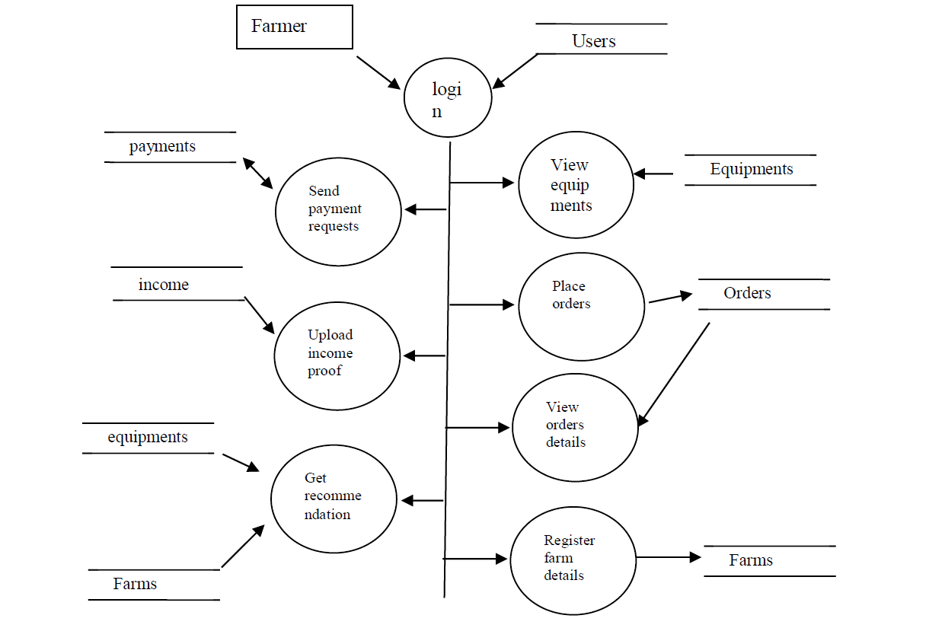

Slide 9
WHAT IS DECISION TREE AND K-MEANS CLUSTERING ALGORITHM
Decision Tree is a Supervised learning technique that can be used for both
classification and Regression problems, but mostly it is preferred for solving
Classification problems.
It is a tree-structured classifier, where internal nodes represent the features
of a dataset, branches represent the decision rules and each leaf node
represents the outcome.
In a Decision tree, there are two nodes, which are the Decision
Node and Leaf Node. Decision nodes are used to make any decision and
have multiple branches, whereas Leaf nodes are the output of those
decisions and do not contain any further branches.
The decisions or the test are performed on the basis of features of the given
dataset.

Slide 10
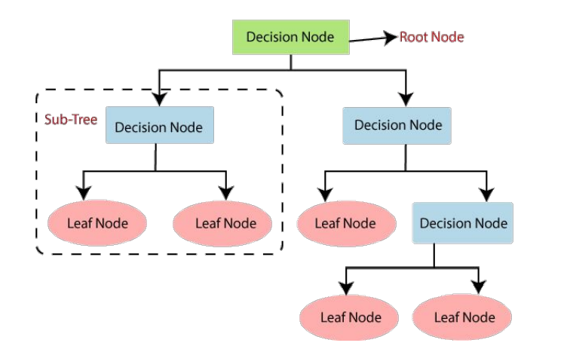
• K-Means Clustering is an Unsupervised Learning algorithm, which groups the unlabeled dataset into different clusters. Here K defines the number of pre-defined clusters that need to be created in the process, as if K=2, there will be two clusters, and for K=3, there will be three clusters, and so on.
• The algorithm takes the unlabeled dataset as input, divides the dataset into k-number of clusters, and repeats the process until it does not find the best clusters. The value of k should be predetermined in this algorithm.
• The k-means clustering algorithm mainly performs two tasks:
– Determines the best value for K center points or centroids by an iterative process.
– Assigns each data point to its closest k-center. Those data points which are near to the
particular K-center, create a cluster.

Slide 11
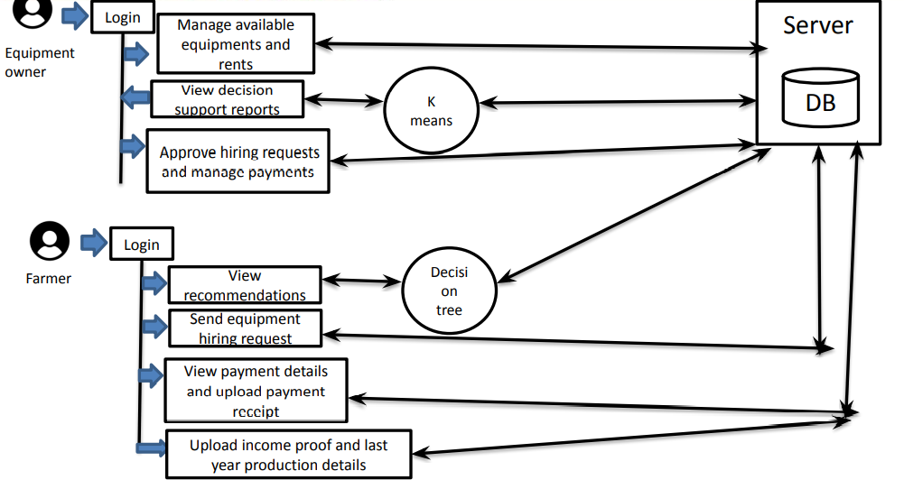
METHADOLOGY

Slide 12
Farming equipment Site can be handled by basically admin and the users will be mainly farmers and equipment distributer.
Farmer can get the recommendations as per the details uploaded by farmer using the decision tree algorithm. Algorithm will test the land type, soil type and the other description mentioned by the farmer and will recommend accordingly. Farmer can send the hiring request and it will be reflected to the owner, also there is criteria for the concession on the rent price according to the income for backward class farmers.
Equipment owner after log in can see the pending hiring request and can approve it . Owner can get the demand of equipments in the market using the algorithm applied known as K means clustering.

Slide 13
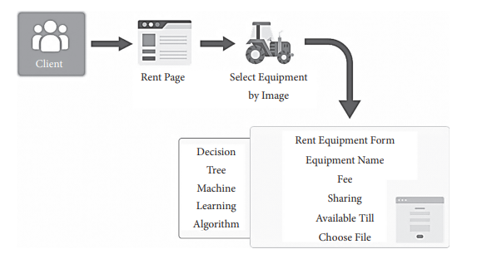
CLIENT SECTION :
Figure represents the systematic approach for renting equipment. The client here can rent and hire the equipment. The client once gets registered will upload the equipment details using the name, dates for displaying in the search list, cost per day, and image of the product. Once the details are filled the request will be submitted. When it gets approved by the admin, the product will be shown on the client dashboard, and a message will be received by the client.

Slide 14
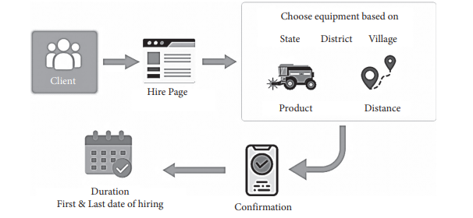
DISTANCE AND COST PREDICTION APPROACH :
The distance here is used for search and distance of client who is hiring the rented equipment. It will allow the client to have a cost variation that depends on the distance from where the equipment is hired.

Slide 15
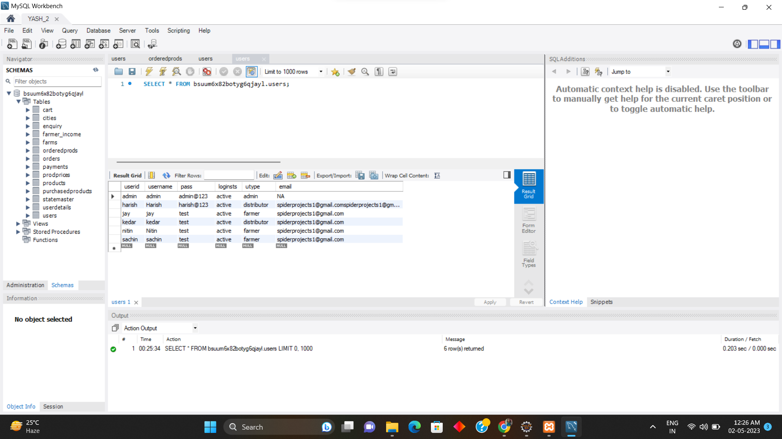
IMPLIMENTATION & RESULTS

Slide 16
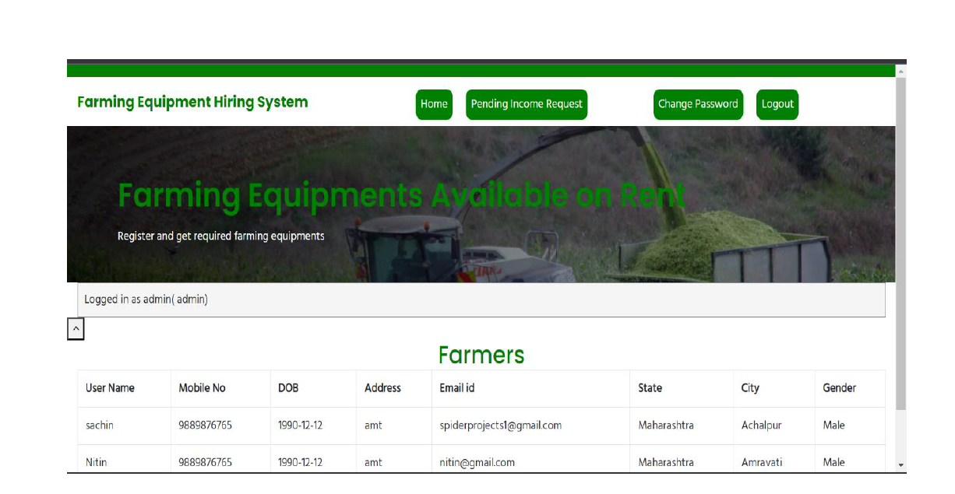
Admin Home Page

Slide 17
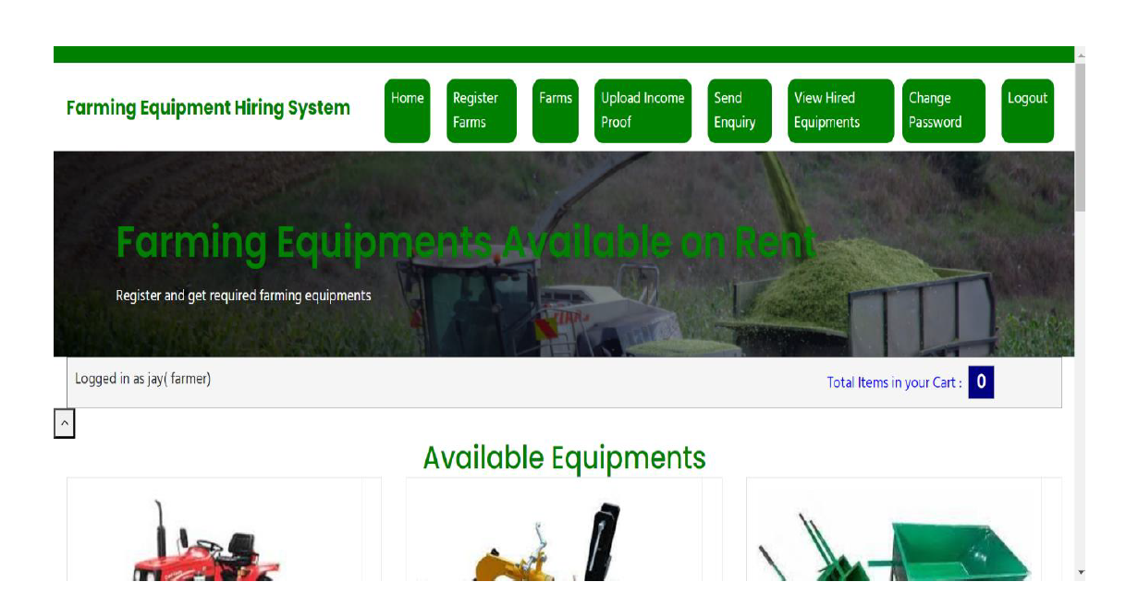
Farmer Home Page

Slide 18
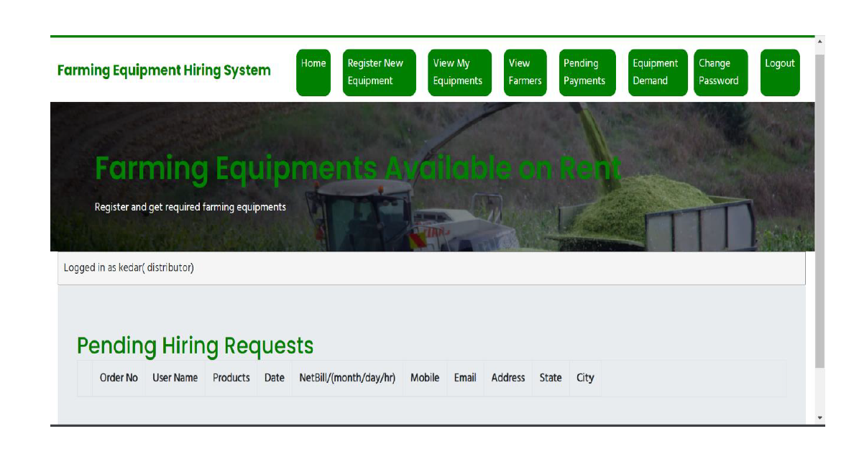
Distributor Home Page

Slide 19
CONCLUSION & FUTURE SCOPE
The research found that farmers lack awareness of current technology, which is extensively used in agricultural operations worldwide. Another barrier is the financial status of farmers, especially small and marginal farms. Farm management loans from commission agents or private firms progressively enslave the farmers. Landlords continue to adopt traditional manufacturing methods despite their ignorance of current production methods. This project developed smart tillage, a platform that enables farmers to rent and lease equipment. The study also built a machine learning model. Decision trees are ideal for machine learning and tool and equipment hiring. It also tries to improve farmers’ quality of life by decreasing labor-intensive tasks. This thesis focuses on smart farming via equipment sharing and leasing. The proposed tasks employing various machine learning techniques were developed as a result of exploratory and highly experimental work; future work is expected to include new experiments as related method and result optimization .

Slide 20
REFERENCES
Sharma J L (1974) An analytical study into custom hiring services vis-`a-vis agricultural resource productivity. M.Sc. Thesis (unpublished), Punjab Agricultural University, Ludhiana, India.
Kaur K (1988) Economics of custom hiring of agricultural machinery in the Punjab state. M.Sc.Thesis (unpublished), Punjab Agricultural University, Ludhiana, India.
Blank S C, Klonsky K and Norris K (1991) Owning harvest equipment versus custom hiring: The case of walnuts.
Bhatia B S (2000) Tractor - a boon or bane for Punjab farmers. The Tribune, Chandigarh Edition, Chandigarh, October 16, 2011. p.4.
Singh V V (2008) Entrepreneurship and rural development. pp 152-164. Kalyani Publishers, New Delhi, India.
Srivastva N S L (1999) Role of agricultural engineering in doubling food production in next ten years.

Slide 21
(2000) Aggarwal and Yadav Economic analysis of utilization of farm tractors in selected districts of Harayana. Agril Engg Today24, pp,14-21.
(2018) B. Nagaraj “Establishing a model custom hiring center: a feasibility study at kandi mandal,” International Journal of Current Microbiology and Applied Sciences, vol. 9, no. 5, pp. 1299–1307.
(2018) D. Alfer’ev, “Artificial intelligence in agriculture,” Agricultural and Lifestock Technology/A[rpIppTfyojla, vol. 4, no. 4.
(2020) A. Gulati and R. Juneja, “Farm mechanization in Indian agriculture with focus on tractors,” SSRN Electronic Journal.
(2019) V. Saiz-Rubio “From smart farming towards agriculture 5.0: a review on crop data management,” Agronomy, vol. 10, no. 2, p. 207.

Slide 22
THANK YOU

